Slide 1


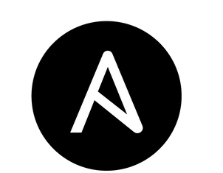


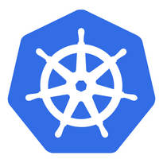









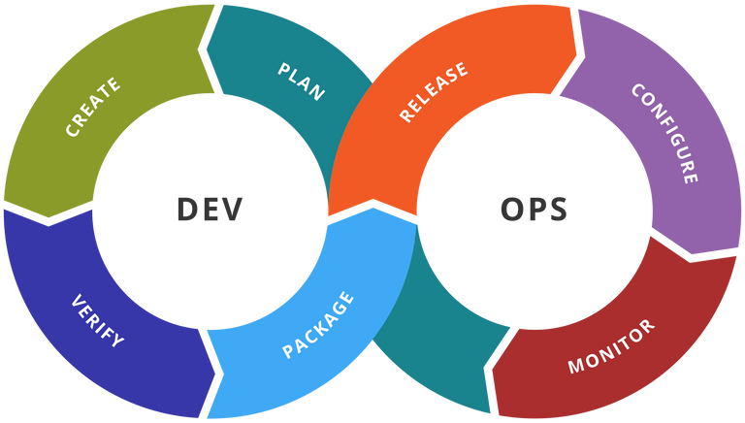

LEARN, SHARE & CARE
CLOUD / DEVOPS / KUBERNETES / AWS / LINUX
Community

Slide 2

About Us
Cloudnloud was started 11 years back with an intention of up-skilling and up-scaling all our members on the technical front with the niche topics around Cloud, DevOps,Data, AI and much More.
Cloudnloud was started by Vijayabalan Balakrishnan Who is a cancer survivor from Jan 2011. He is helping the Tech community and Cancer Children for the past 2 decades to loud from their own confidence in the IT industry. Officially it has become a registered Pvt Ltd on Jan-2015 to help and support cancer children from its revenue. Today Cloudnloud is living that dream with 6000 plus cancer children's survivors across the Globe.
WHO WE ARE
Community
02

Slide 3


Sibin John
An expereinced SRE/DevOps Engineer with 10+ years experience in infrastructure operations and managed services with hands on experience in Cloud, Devops, Linux, Virtualization, and web hosting.
Technologies known: AWS, Kubernetes, Terraform, Ansible, Linux, Observability and logging tools like Datadog, ELK, etc
Certifications:
Certified Kubernetes Administrator
Certified Kubernetes Application Developer
LinkedIn: https://www.linkedin.com/in/sibinjohn19
[Your Good Photo]

Slide 4


Deploy a simple webapp in AWS

Slide 5

1
Introduction to the Session
Today's
Agenda
2
Team Check-in and Icebreaker
3
Stop Start Continue
4
Summary and Action Items
Community

Slide 6
This session is to discuss, to study and redesign an application infra deployed to AWS
Community

Slide 7
What is current architecture? We have a web application deployed in aws with simple architecture using ec2 instance, RDS, nat gateway, Load balancer and Route 53
Community

Slide 8
What are the areas we need to improve w.r.to current infra?
1. Latency due to static contents
2. No CDN to improve the loading speed
3. No auto scaling implemented in two zones where the app is deployed
Community

Slide 9
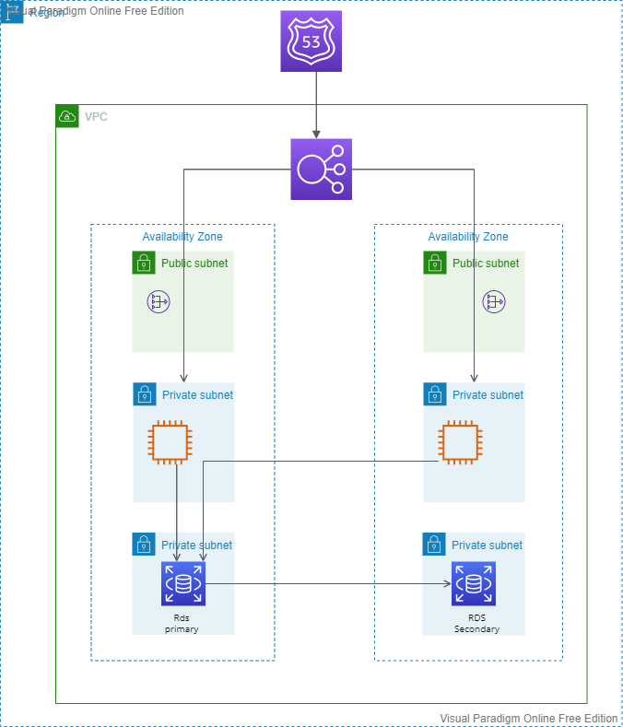
Current architecture
Community

Slide 10
Improvements we can suggest:
1. Segregate the stack to three App, DB and Web 2. Use content caching to improve static content loading
3. Use query caching to improve DB performance
4. Add autoscaling to the instances to handle load during peak time
5. Security enhancements using Firewall and DDoS protection
Community

Slide 11
New aws services to introduce:
1. Cloudfront as CDN
2. AWS ASG for EC2 nodes
3. Amazon Elasticache for query caching
4. AWS S3
5. AWS WAF
6. AWS Shield
Community

Slide 12
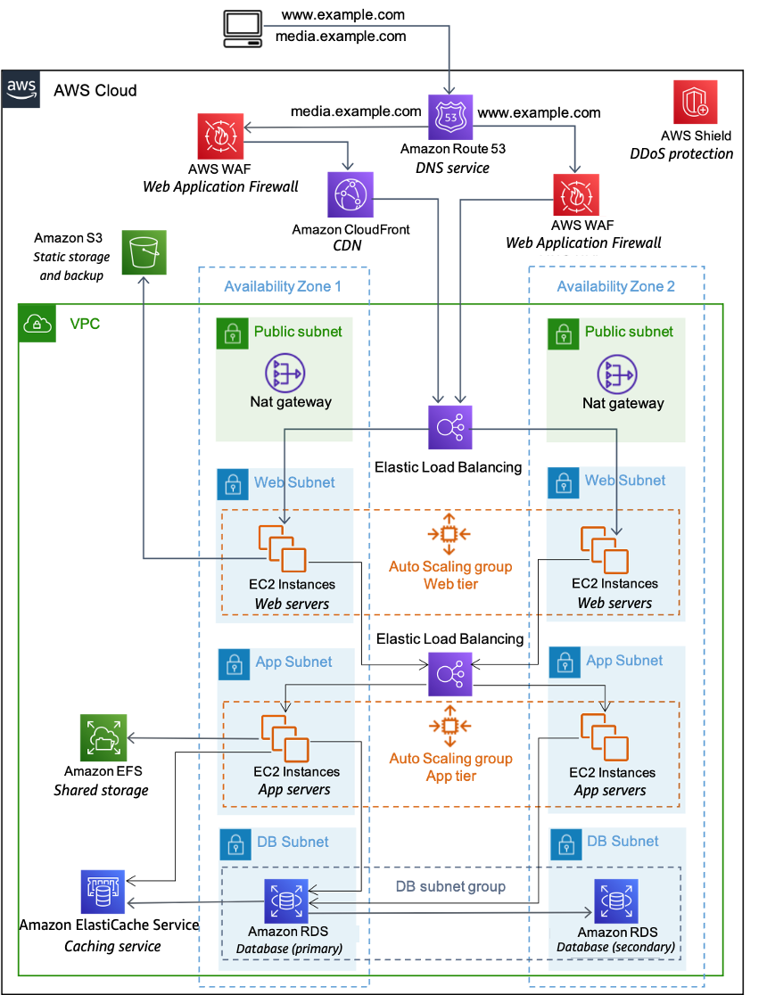
Proposed architecture
Community

Slide 13











Community
Connect Us to Loud better
cloudnloud
Join Discord Channel
cloudnloud.com
info@cloudnloud.com

